Slide 1
Long-Term Electricity Price Prediction
Shikhar Verma, Nami Saghaei, Kun Yang, Randell Espina, Maria Sheila Ramos,
Ashkan Yousefi
Mentors: Antonio Vitti, CFO formerly with Merchant Atlas, Inc. Dr. Steven Gustafson, Chief Scientist at Maana

Slide 2
Objective
Predict the monthly retail price of electricity 3-5 years in advance.

Slide 3
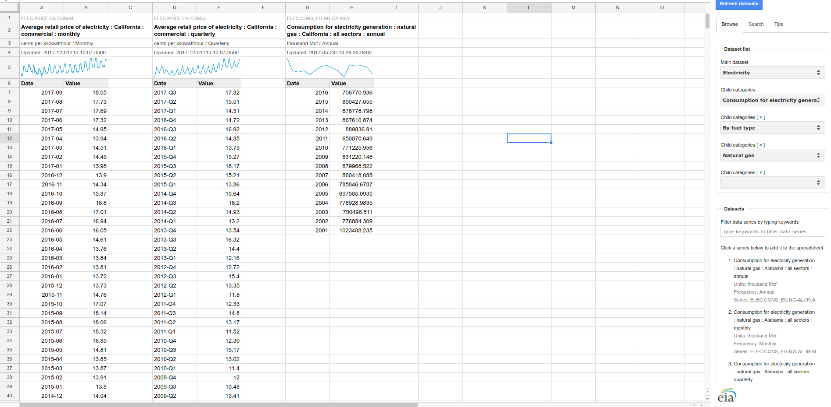



Data Collection and Cleaning
EIA “OpenData” Database
Biggest hiccup was finding enough data…
Spent majority of time selecting, cleaning, formatting, and merging data.
Up to last week we had 13 columns in our potential feature matrix. Now we have 78.
Notes:
API - application programming interface
But thankfully, we found a database provided by the Department of Energy, constantly updated, with a nice API and accurate information.

Slide 4
Correlation Analysis
For feature selection

Slide 5
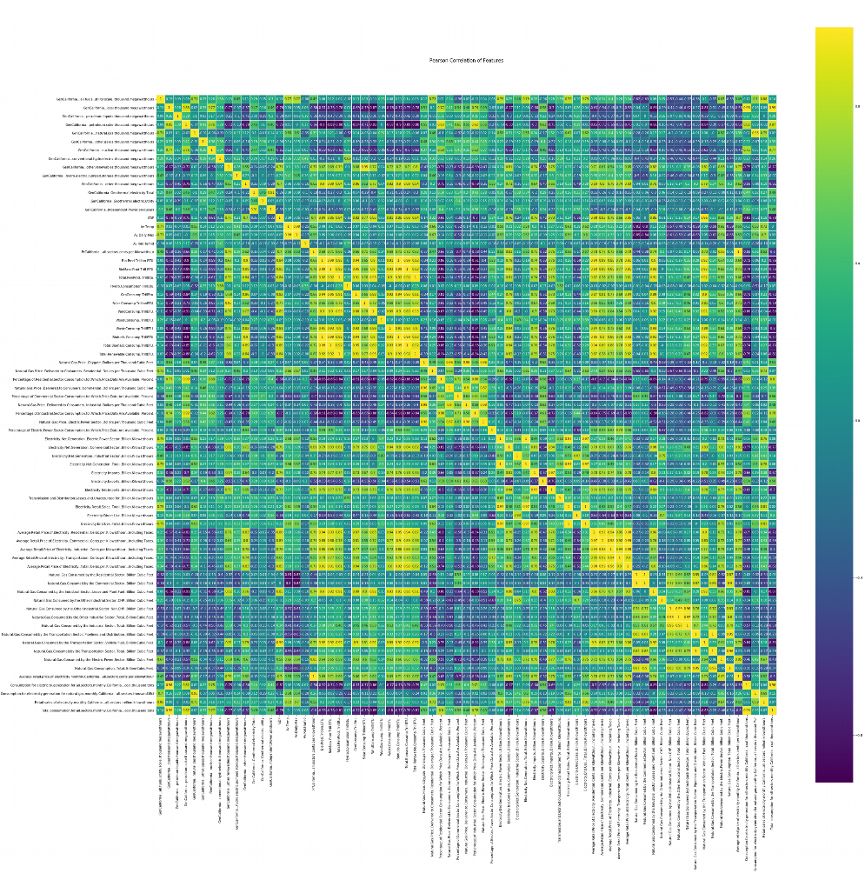
Notes:
This is looking at all sorts of energy production and usage statistics in different sectors, GDP, imports/exports, etc.

Slide 6
GDP
Renewables Consumption
...and Average Retail Electricity Price

Slide 7
Renewables Production
Bio
Geo
Solar
Wind
Hydro
Waste
Total Renewables

Slide 8
Natural Gas Price
Electricity Price
Different Sectors
Residential
Commercial
Inudstrial

Slide 9
Net Generation
Exports/Imports
in different sectors
Notes:
Correlated because in wintertime, as generation peaks, then consumption peaks and prices rise.

Slide 10
Average Electricity
Retail Price
Different Sectors/
Units

Slide 11
Natural Gas
Consumption and Production by sector.

Slide 12
Petroleum Coke
and Coal Generation
… And
Average Monthly Retail Price of Electricity

Slide 13
Renewables Production and
Consumption
Bio
Geo
Solar
Wind
Hydro
Waste
Total Renewables
And…
Average Monthly Retail Electricity Price in different sectors.
Electricity Import Price
Notes:
But this was a huge find for us, and we think it really helped us get a good model. The hypothesis at the time was “When electricity gets expensive, people increasingly resort to renewables”.
Perturbances, political events and stuff that cant be modeled
Why is this problem hard? Nobody has solved this problem
Make a sexy presentation,: talk about assumptions that you made, models, what you used from the class, future applications.
Talk about the problem clearly and why it is difficult, what approaches have you taken and why are those approaches valuable,
Extrapolating from solar if renewable model is amazing.
Sound like experts tomorrow and sound proud of the work that you have done.
Have good visualizations. They want to see graphs.
Graded on effort, Logic and Clarity; show pictures that tie into the story, no big question marks “What are they talking about?”, no crazy visualization, no talking about stuff you don’t understand what you’ve done.
You frame the result and sell it to them, but talk about the limitations. show that you’ve spent time understanding the problem. “I couldn’t do this with the model i have now”

Slide 14
Correlations Summary (Features)
GDP (.7)
Natural Gas Consumed by Industrial Sector (.74)
Natural Gas Consumed by Electric Power Sector (.85)
Net Electricity Imports (.75)
Net Electricity Generation (.81)
Renewables (.77)
Solar Consumption (.71)
Geothermal Consumption (.65)
Wind Consumption (.62)
Biofuels Production (.72)
Coal Generation (-.75)

Slide 15
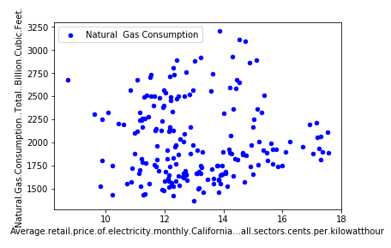
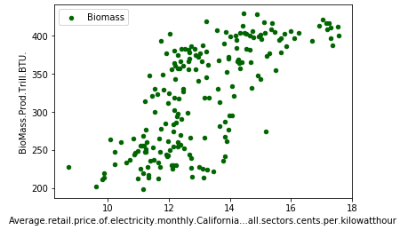
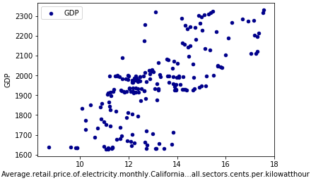
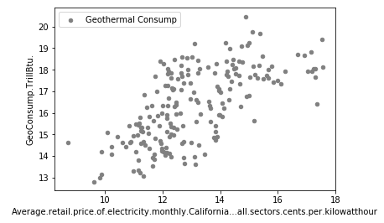

Slide 16
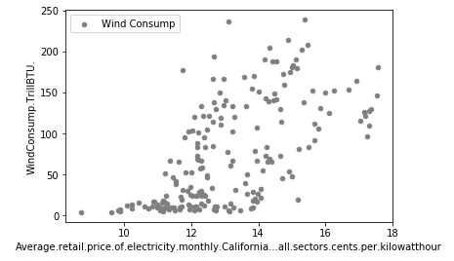
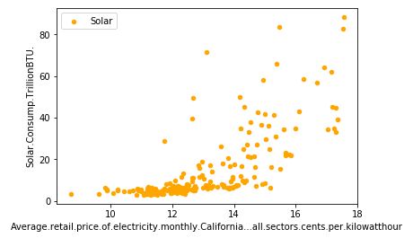
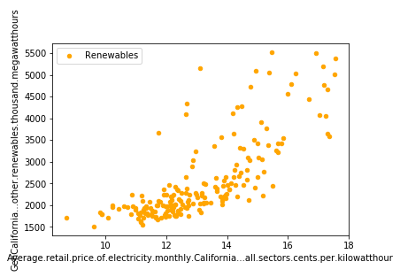
Notes:
But check this out. Why is this so interesting? Because it shows a potentially causal relationship.
From a macroeconomics perspective, renewables are not well-established like Oil, Coal, or Gas, all of which have thousands of non-quantifiable factors that come into play when determining price. It turns out that the main driver behind production and consumption of renewable energy is still people. Renewable production/consumption more or less goes up when people want it, and down when people don’t want it.
When electricity is cheap, there is no incentive for people to incur the heavy startup costs of buying $10,000+ solar solutions. And when electricity gets more and more expensive and solar adoption is the best in the country, then people feel comfortable switching to renewables because the math checks out, they save money.
There’s a behavioral economics angle to this, but it basically boils down to whether or not it’s worth it for people.
This shows that there is a quantifiable relationship between adoption of renewable energy and the price of electricity, and that is great news for our model! It basically means that, because of its relatively renewable-friendly climate, California energy prices can be a lot more predictable than probably the rest of the country.
Huge finding. More than a third of our features were renewables, so this really made prices in California much more predictable, and it’s definitely something that we can’t rely on for the rest of the country, so our model is really tuned for California.

Slide 17
Prediction
Time Series

Slide 18
Prediction with Time Series
Time Series Prediction (Autoregressive Integrated Moving Average or ARIMA) for 3 years in advance - train 2000-2014, test 2014-2017, predict 2017-2020.
… for 5 years in advance - train 2000-2012, test 2012-2017, predict 2017-2022.

Slide 19
Time Series Results
Time Series Prediction for 3 years performed superbly.
Considered Cross-validation, but discovered that doesn’t work well with time series because it misses trends and captures other erroneous trends. Time series depends on history.
Time Series for 5 years performed slightly worse, but still good.
Notes:
So here was the plan for prediction. After trying tens of different ideas up until literally the last second (Alex knows what we’re talking about), we started with a relatively simple time series prediction.

Slide 20
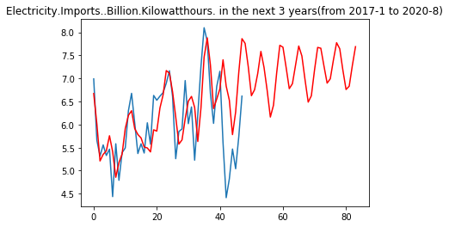
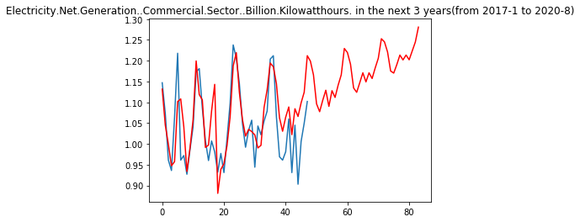
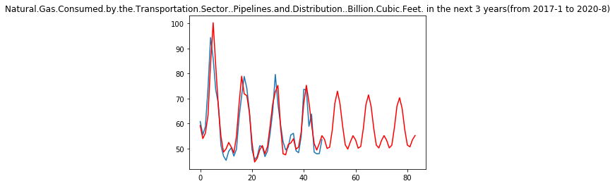
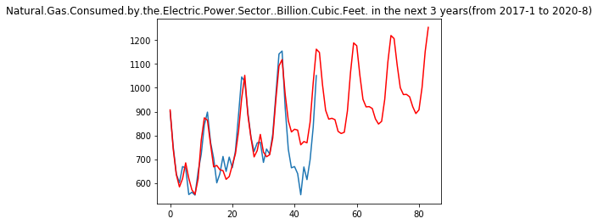
Net Commercial Generation (3 Years)
Electricity Imports (3 Years)
Billion Kilowatt-hours
Billion Kilowatt-hours
Months
Months
Natural Gas Consumed by Industrial Sector (3 Years)
Natural Gas Consumed by Electric Power Sector (3 Years)
Billion Cubic Feet
Billion Cubic Feet
Months
Months

Slide 21
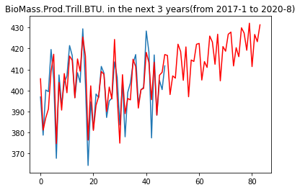
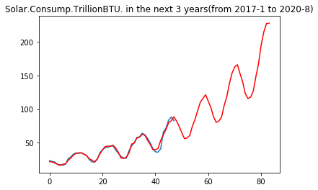
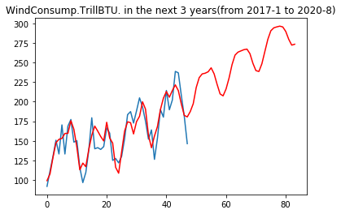
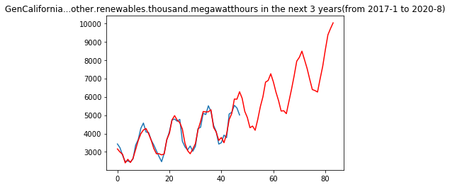
Biomass Production (3 Years)
Solar Consumption (3 Years)
Trillion BTU
Trillion BTU
Months
Months
Wind Consumption (3 Years)
CA Renewable Generation (3 Years)
Trillion BTU
Thousand Megawatt-hours
Months
Months
Notes:
Solar is interesting, although we will get into the politics in a second.

Slide 22
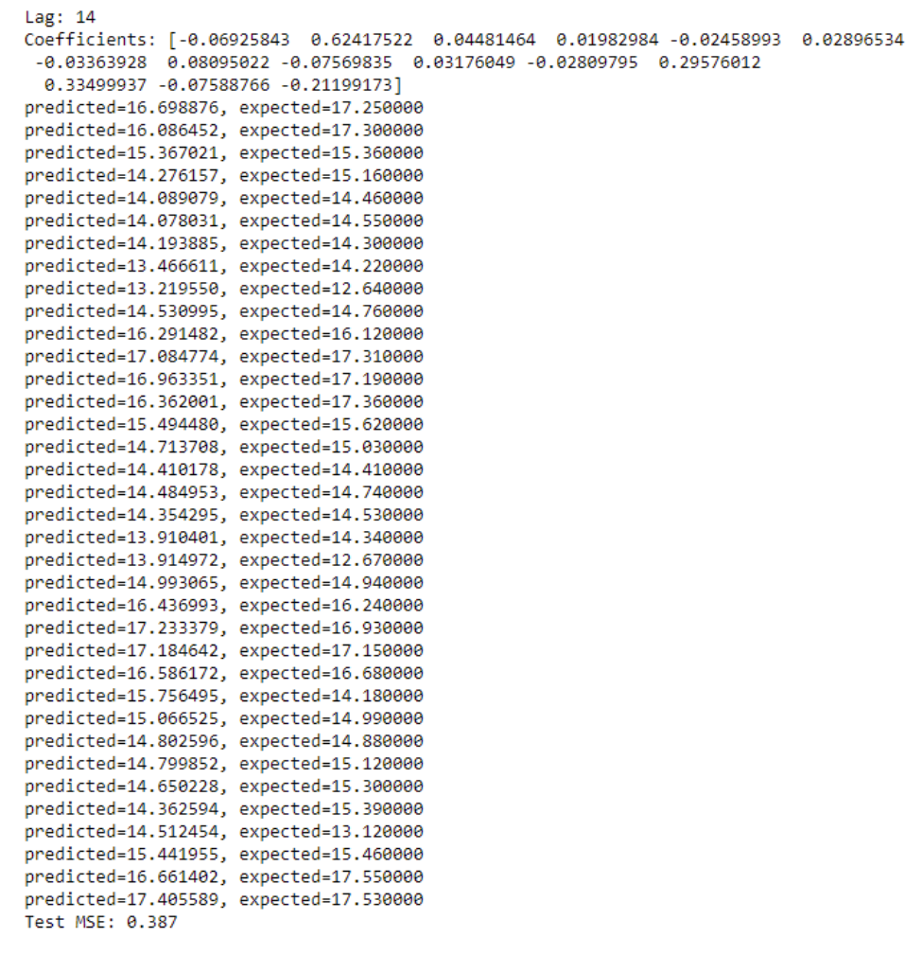
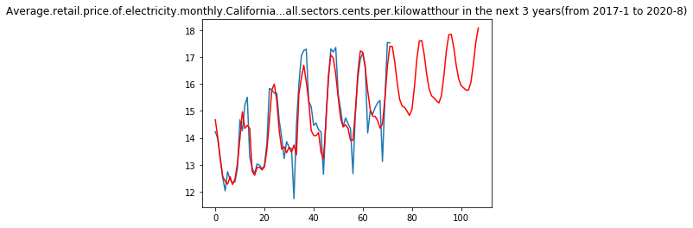
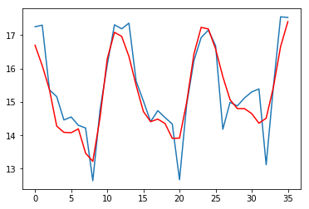
Average Monthly Retail Electricity Price (3 Years)
Cents per Killowatt-hour
Months
Notes:
Always within 1 Cent from True Values. These are, on average, off by .38 cents.
For 5 years, it works bad with an MSE of 4.972

Slide 23
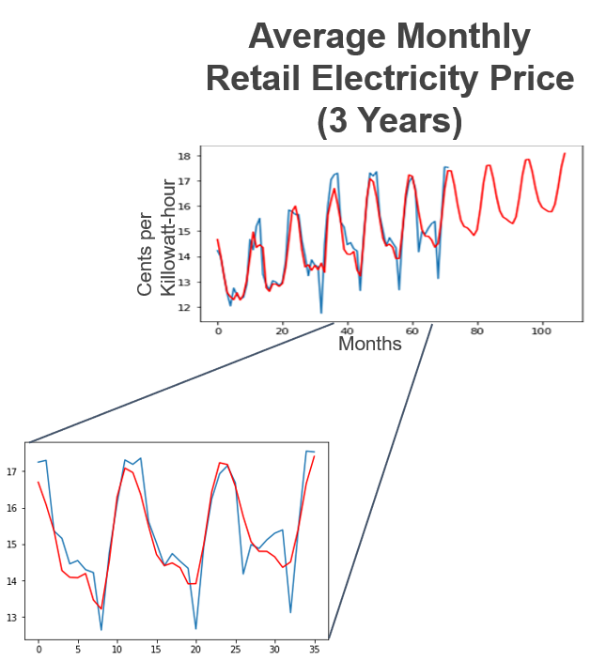
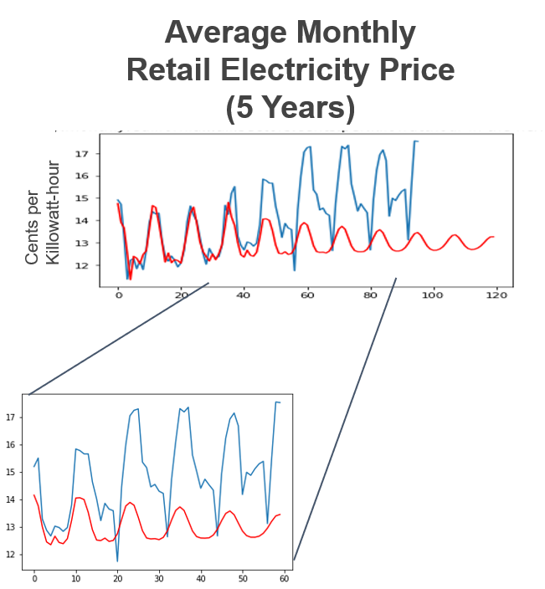
MSE (Mean Square Error)=0.38
MSE (Mean Square Error)=4.972
Notes:
Always within 1 Cent from True Values. These are, on average, off by .38 cents.
For 5 years, it works bad with an MSE of 4.972

Slide 24
Hand-Picked Features Model
Use Time Series to predict value of features in the future.
Train a model with the highest-correlated features.
Apply coefficients of tuned algorithm as weights to projected features.
Notes:
Treat Time Series prediction of feature data as synthetic data augmentation, train predictor on current features, predict based on projected features. Beat the 5 year.
SRIMA Model
GDP and Oil Supplies

Slide 25
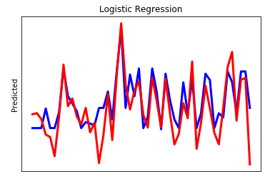
Logistic Regression

Slide 26
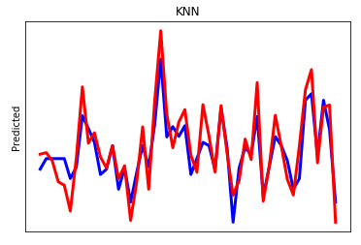
KNN

Slide 27
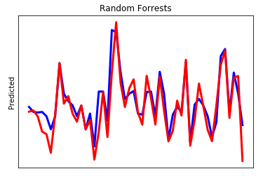
Random Forrests

Slide 28
Conclusions
3-Year Prediction
Time series model performed superbly.
Will investigate trained model with projected feature data next.
5-Year Prediction
Time series model did not perform great, but tuned model with time series predicted feature data performed much better.

Slide 29
Conclusions
So many factors:
Political Climate
Economic Climate
Corporate Decisions
Weather and Climate Patterns (next week at best)
Usage Patterns (next week at best)
OPEC
Foreign Policy
One really hard aspect of this problem (and one of the main reasons nobody has really solved this problem) is that these factors pretty much cannot be predicted, and, unfortunately, they affect prices pretty drastically.
Notes:
Of course, despite all this, these are things that our model cannot capture explicitly right now, other than the trends being built into the last years’ data and being picked up automatically.
One thing we would like to do in the future, given more time and resources, is to look at a way to provide several estimates to be tuned with domain knowledge and perturbances.
Publication. Contact Iklhaq for help.
Common Filter
Rannaissance Technlogies - Weather in France for Stock prices in China (Importance of huge correlation matrix for finding seemingly unrelated data that ends up being really correlated).
ICO as a liquid representation of energy assets
Virtual Balance Sheet-less banking platform with self-enforcing contracts
Enhanced trust and security from blockchain
Backed by actual assets, anonymity
Courses:
Haas Energy Technology Course
Goldman School of Public Policy Energy Prediction Course

Slide 30
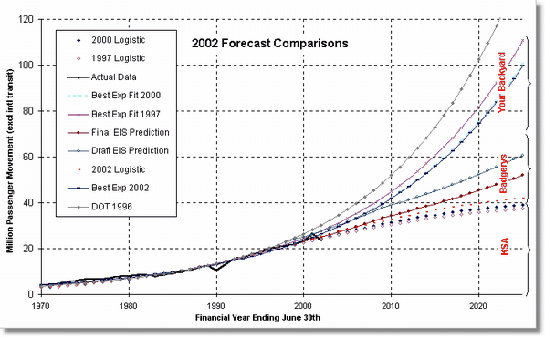
Conclusions
Perturbance Flexible + Confidence Intervals
Notes:
One thing we would like to do in the future, given more time and resources, is to treat these factors as “perturbations”, and look at a way to provide several estimates to be tuned with domain knowledge and different scenarios.

Slide 31
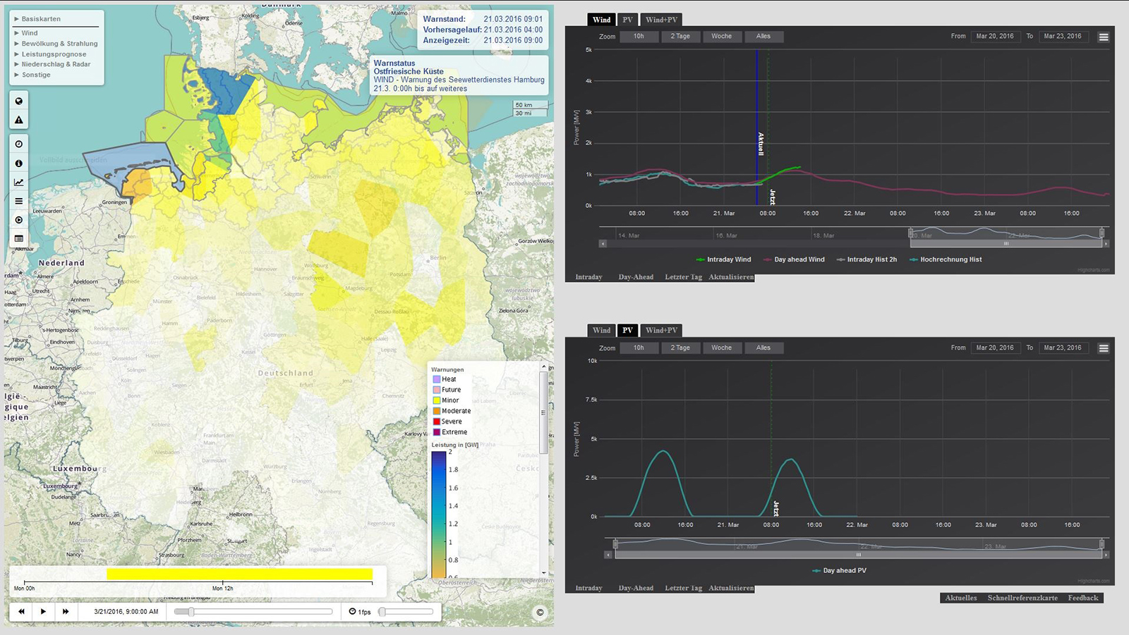
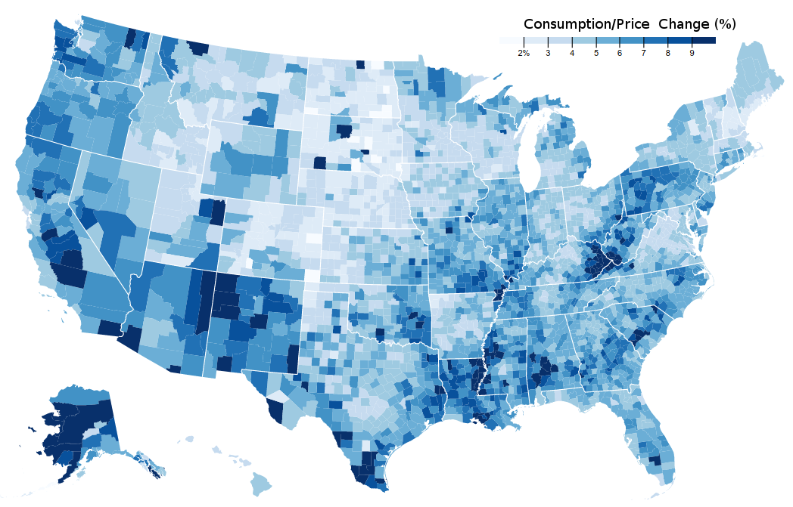
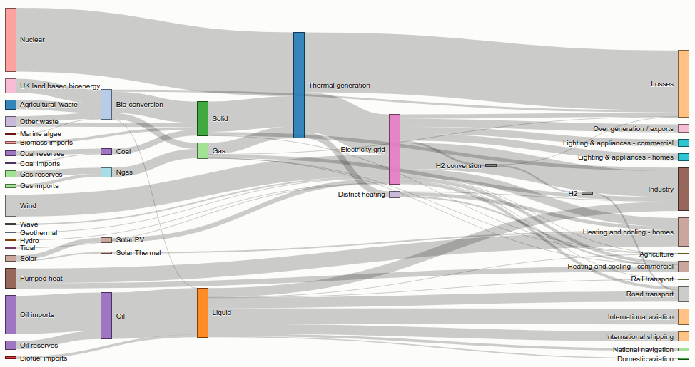
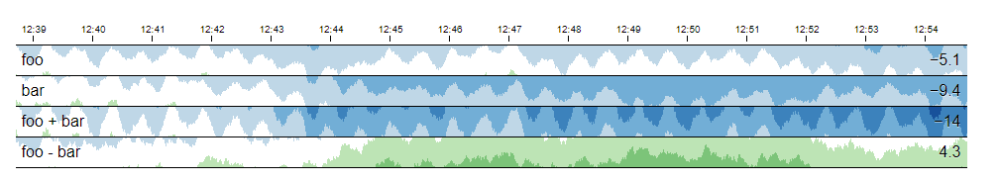
Visualization
Terminal

Slide 32
Technical Components
Interface
Interactive Interface
Online Learning
Perturbance-Flexible Front End
User Domain Knowledge Input
Real Time Data Visualization
Prediction
Linear Regression
Time Series
Random Forest Regressor
Vector autoregressive model (ARIMA)
Linear Dynamic Systems
Gaussian State Space Models
Techniques
Synthetic Data Augmentation
Automated Database Query and processing (Pipelining)
Online Learning
Cross Validation

Slide 33
Next Steps
Try a new fuzzy model for more precise time series prediction (maybe tweak Random Forest)
Provide perturbance flexibility with confidence intervals (and a way to quantify perturbations).
Develop User Interface, reason about user domain knowledge input, look into online learning with constant feedback into pipeline, and find more data.

Slide 34
Thanks!
Any questions ?

